Slide 1

Strategy Identification, Study, Decision and Implementation
Campus Community Update
Responsible
Area
Campus Community
Strategy Study Team
President's Cabinet
Vice Presidents Group w/a Strategy Specific Review Team
Vice Presidents Group
Decide, Resource, Direct
Strategy Team’s Recommendations and Action Plans Reviewed
Implement and Measure Evidence
Strategy Studied; Input Sought; Recommendations and Action Plans Developed
Strategies Proposed
Strategy Proposals Reviewed; Study Teams Impaneled for Those Advanced

Slide 2


Slide 3

Career Integration committee
SFA Envisioned
Strategic Plan
April 7, 2016

Slide 4

Committee Charge
Fostering Academic & Co-Curricular Innovation
“Infuse career development experiences throughout a student's academic, co-curricular and extracurricular experience while at SFA.”

Slide 5
Strategies
Strategy 1: Promote ‘soft skills’ development
Strategy 2: Increase connections between student affairs, academic affairs and the local business community
Strategy 3: Provide training to promote career readiness
Strategy 4: Collect direct assessment of student learning that can support compliance with the “marketable skills” initiative of the THECB and align with core assessment.
Strategy 5: Change of philosophy and name of Career Services

Slide 6
Strategy 1: Promote ‘soft skills’ Development
Rationale : More than 50% of SFA’s graduates are first-generation college students. These students often lack “polish” and need transformative experiences.
Action Step 1: Creating a program to help promote student learning (especially soft skills) from on-campus jobs and off-campus jobs. (SIMILAR TO IOWA GROW)
Action Step 2: Create marketing to promote the development of soft skills to students and faculty.
Action Step 3: Develop connections between Academic and Student Affairs using the Certified Student Leader program based on the ten skills and competencies identified as most desired by employers conducted by the National Association of Colleges and Employers.

Slide 7


How is this job fitting in with your academics?
What are you learning here that’s helping you in school?
What are you learning in class that you can apply here at work?
Can you give me a couple of examples of things you’ve learned here that you think you’ll use in your chosen profession?

Slide 8

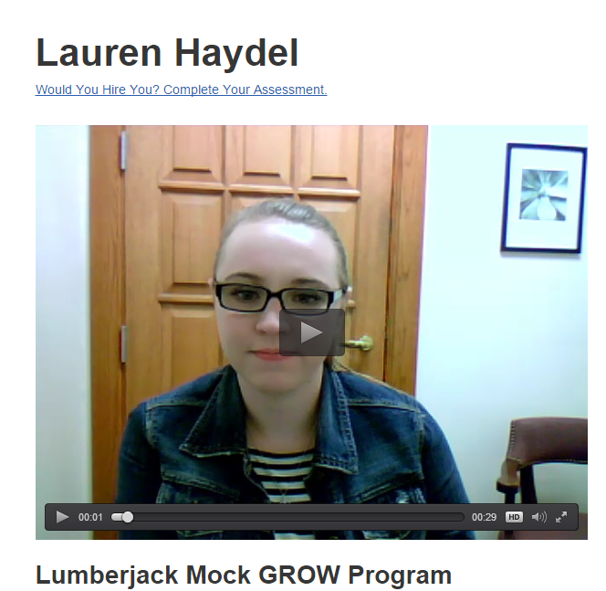
What are you learning in your job that’s helping you in school?
What are you learning in class that you can apply at your job?
Does your job give you the opportunity to develop the skill of speaking with and listing to others? If so, what have you learned?
Has your job taught you anything about serving as a member of a team? If so, what have you learned?
Has your job taught you anything about influencing people, motivating others or selling to others? If so, what have you learned?
Has your job taught you anything about setting priorities or planning complex initiatives? If so, how?
Has your job taught you anything about making decisions or solving problems? If so, how?
Can you give me a couple of examples of things you’ve learned here that you think you’ll use in your chosen profession?
DRAFT

Slide 9
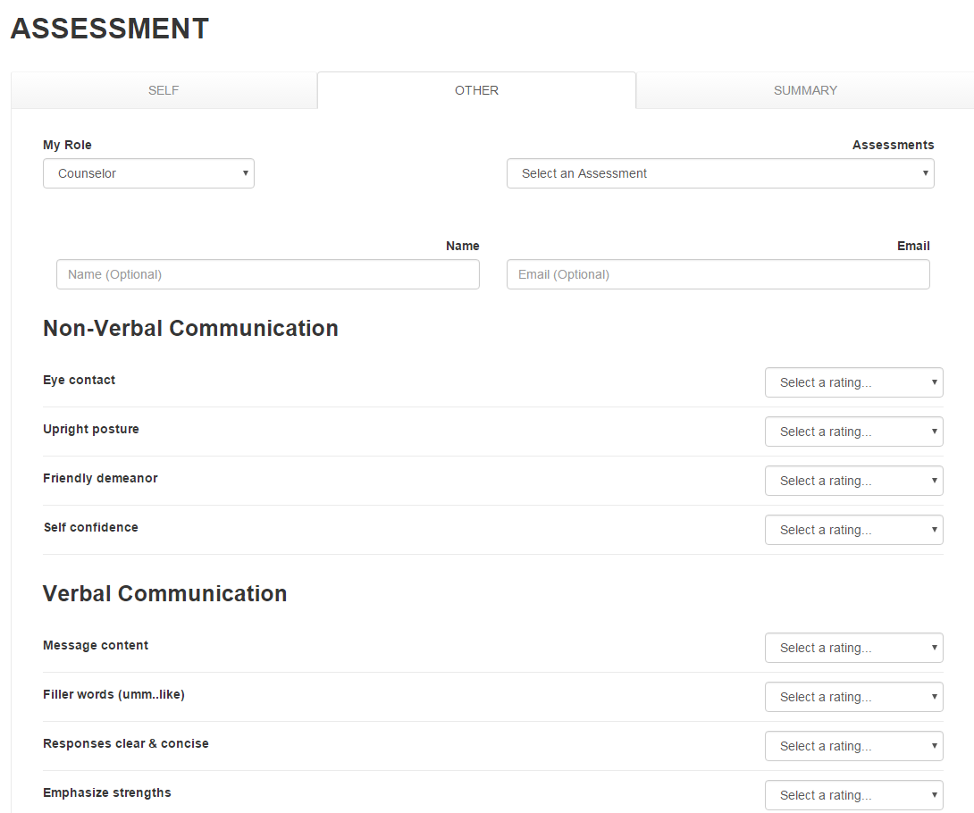

Slide 10


Slide 11
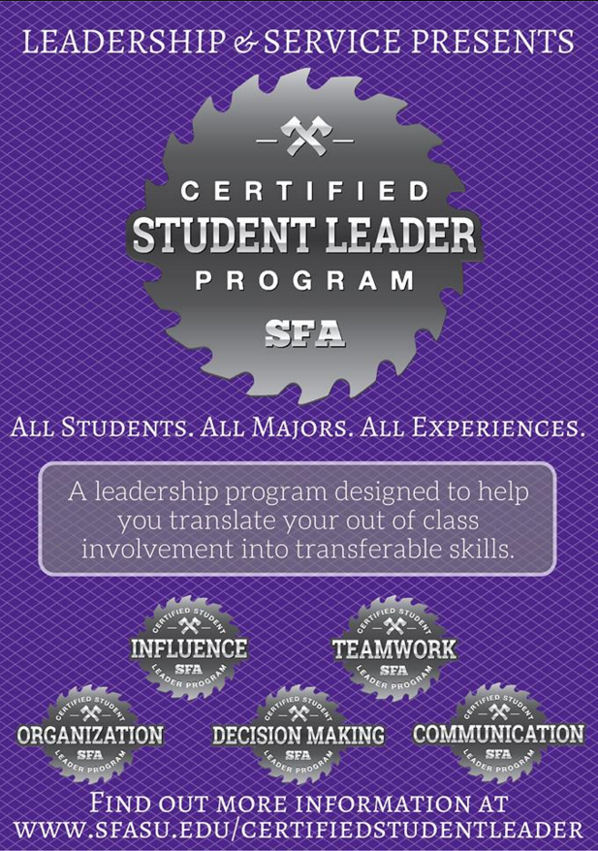
In the 60x30 TX plan, the THECB wrote, “Students, however, are not always aware of the value of these skills or able to articulate them to employers.” This is the basis of this program.

Slide 12
Strategy 2: increase connections
Rationale : Effective career development requires coordination between academic affairs, student affairs and the local community.
Action Step 1: Connect each college to Career Services through a dedicated career services employee assigned to that college. These employees would develop discipline-specific expertise, hold regular events in the college to which they are assigned and interface with college leadership about ways to improve our services to their specific students.
Action Step 2: Create a “Faculty Career Fellows” program where faculty could be selected, given course releases and help to coordinate career initiatives within the college.
Action Step 3: Increase the visibility of internships and practical experiences by marketing Jobs4Jacks to students, employers and academic programs.

Slide 13
Strategy 3: provide training
Rationale : We believe that the best way to meet the needs of students and academic programs is by providing programs that can serve as resources for students without burdening academic areas.
Action Step 1: Develop a D2L module for training students prior to beginning an internship and encourage academic programs who do not already provide this kind of training to adopt the program.
Action Step 2: Create a program for graduating seniors that provides them an orientation to the world of work.

Slide 14


Slide 15
Strategy 4: Collect direct assessment of student learning that can support compliance with the “marketable skills” initiative of the THECB and align with core assessment.
Rationale : In the 60x30 TX plan, the Texas Higher Education Coordinating Board (THECB) points out that, “The Texas higher education Core Curriculum (includes) six Core Objectives, which include the marketable skills of communications, critical thinking, and teamwork. Strategies which assess “marketable skills” could dovetail easily with core curriculum assessment.
Action Step 1: Promoting participation in the Certified Student Leader program can produce direct assessment of student learning that could be useful for assessment of the co-curriculum.
Action Step 2: Encouraging broad participation by on-campus employers could produce excellent direct assessment of student learning from employment. Rubric assessment of students participating in “Lumberjack Grow,” could connect with Core Curriculum Assessment.

Slide 16
Strategy 5: change of philosophy and name of career services
Rationale : The term “services” harkens to a bygone era in Career Development. It signals a program that is out of date. Career and Professional Development is a more contemporary approach and better articulates the new philosophy we are suggesting.
Action Step 1: Change the name of the Office of Career Services to the Center for Career and Professional Development. This name change will reflect the growing trend of focusing on the need for helping students develop the skills employers desire most and is compatible with the desire to mold and shape students for their future careers.

Slide 17








Slide 18
Implementation
Action Steps | Timeline | Implementation | Funding
Creating a program to help promote student learning (especially soft skills) from on-campus jobs and off-campus jobs. (SIMILAR TO IOWA GROW) | Implement by Fall 2016 | Assign to the University Affairs Assessment Committee (will consult and involve academic affairs staff) | We will require funding to hire additional student career advocates. This is detailed below.
Hire additional Student Career Advocates to handle increased workload from the Lumberjack Grow program and to assist in resume critiques and other programs and services of Career Services. We would propose this to the Student Service Fee hearing committee for funding. | Implement by Fall 2017 | Career Services will select and train new Student Career Advocates. | Career Services currently has seven Student Career Advocates. We project that we will need a total of 15 (increase of 8). The average pay of these positions is 8.25 per hour. At 20 hours per week and 25 weeks per year, that would require an additional $33,000 per year. (wage x hours x weeks x positions).
Create marketing to promote the development of soft skills to students and faculty. | Implement by Fall 2016 (State of the University) | Daniel Anguiano, Assistant Professor of Art will coordinate this project with guidance from the current Career Integration Committee | The anticipated cost is $1,500. This can be accomplished with existing funding.
Develop connections between Academic and Student Affairs using the Certified Student Leader program based on the ten skills and competencies identified as most desired by employers conducted by the National Association of Colleges and Employers. | Implement by Fall 2017 | Create working teams in interested colleges which could be guided by Career Services and Leadership and Service staff in order to integrate the Certified Student Leader program in to academic programs and initiatives. | This can be accomplished through existing funding. Though depending on the number of colleges that adopt the program, we may need to find a way to recruit and compensate reviewers.
Connect each college to Career Services through a dedicated career services employee assigned to that college. These employees would develop discipline-specific expertise, hold regular events in the college to which they are assigned and interface with college leadership about ways to improve our services to their specific students. This goal is dependent upon the Faculty Career Fellows for support. | Implement by Spring 2017 | Career Services will develop a plan which balances the background and experiences of each team member with the size of the college to attempt to balance the workload. This would be done in consultation with the colleges. | This can be accomplished through existing funding.
Create a “Faculty Career Fellows” program where faculty could be selected, given course releases and help to coordinate career initiatives within the college. | Implement by Fall 2017 | The plan should be developed and refined by the Academic Deans. | The cost of one course release in each college should be calculated.

Slide 19
Implementation
Action Steps | Timeline | Implementation | Funding
Increase the visibility of internships and practical experiences by marketing Jobs4Jacks to students, employers and academic programs. | Implement by Fall 2016 | Career Services will develop a marketing plan. | This can be accomplished through existing funding.
Develop a D2L module for training students prior to beginning an internship and encourage academic programs who do not already provide this kind of training to adopt the program. | Implement by Spring 2018 | A working group comprised of “Faculty Career Fellows” will develop this resource. | This can be accomplished through existing funding.
Create a program for graduating seniors that provides them an orientation to the world of work. | Implement by Spring 2017 | Career Services will develop a working group comprised of Career Services staff and faculty to implement this program. | The anticipated cost is $1,500. This can be accomplished with existing funding.
Promoting participation in the Certified Student Leader program can produce direct assessment of student learning that could be useful for assessment of the co-curriculum. | Implement by Spring 2017 | The Dean of Student Affairs will work with Student Learning and Institutional Assessment to coordinate these assessment efforts. | This can be accomplished through existing funding.
Encouraging broad participation by on-campus employers could produce excellent direct assessment of student learning from employment. Rubric assessment of students participating in “Lumberjack Grow,” could connect with Core Curriculum Assessment. | Implement by Spring 2017 | The Dean of Student Affairs will work with Student Learning and Institutional Assessment to coordinate these assessment efforts. | This can be accomplished through existing funding.
Change the name of the Office of Career Services to the Center for Career and Professional Development. This name change will reflect the growing trend of focusing on the need for helping students develop the skills employers desire most and is compatible with the desire to mold and shape students for their future careers. | Implement by Fall 2016 | Career Services staff will manage this transition. Materials such as letterhead will be replaced as they are used. | The anticipated initial cost is $1,000. This can be accomplished with existing funding.

Slide 20
Strategies
Strategy 1: Promote ‘soft skills’ development
Strategy 2: Increase connections between student affairs, academic affairs and the local business community
Strategy 3: Provide training to promote career readiness
Strategy 4: Collect direct assessment of student learning that can support compliance with the “marketable skills” initiative of the THECB and align with core assessment.
Strategy 5: Change of philosophy and name of Career Services

